Slide 1
ME30 Project 3 Dynamic Data Ingestion and Storage in HDFS with Automated Hive Integration) DE_ Dynamic Data Ingestion and Storage in HDFS with Automated Hive Integration

Slide 2
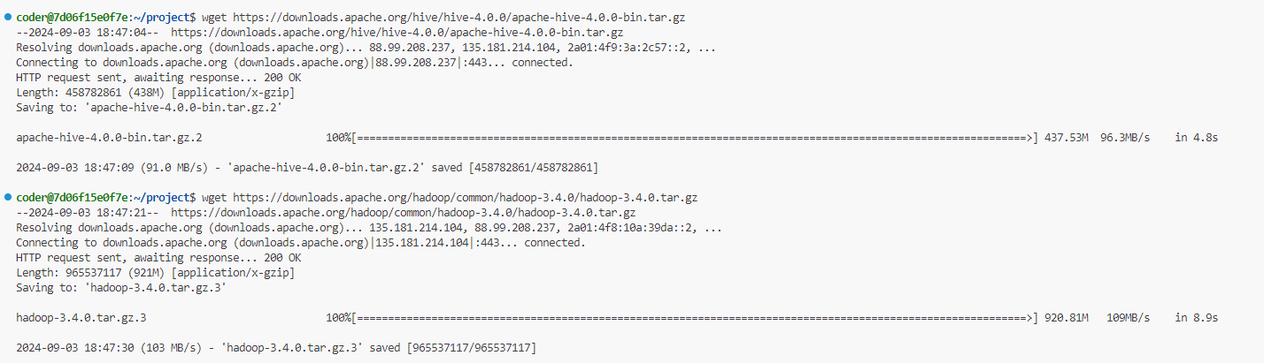
INSTALL (WGET) HIVE AND HADOOP

Slide 3
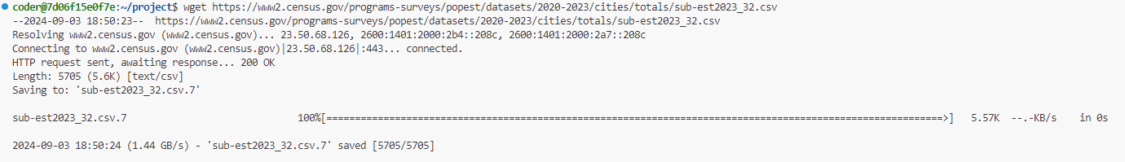
DOWNLOAD THE FILE FROM(wget https://www2.census.gov/programs-surveys/popest/datasets/2020-2023/cities/totals/sub-est2023_32.csv)

Slide 4
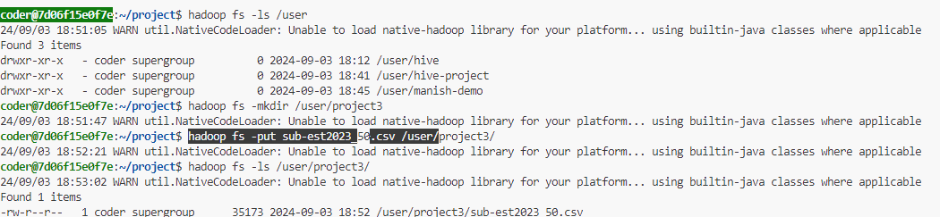
CREATE NEW DIRECTORY AND PUT THE FILE IN THE NEW DIRECTORY

Slide 5
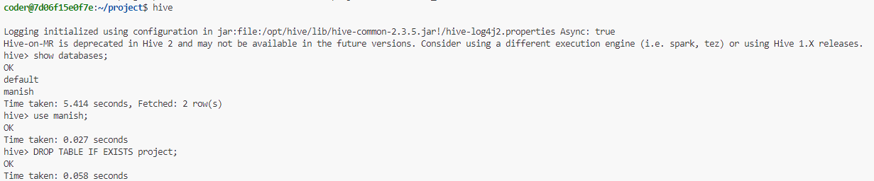
GET INTO HIVE AND SELECT THE DATABASE OR CREATE NEW DATABASE AND USE IT

Slide 6
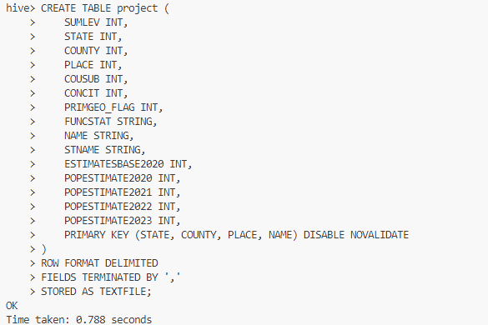
CREATE A TABLE IN HIVE

Slide 7

LOAD THE TABLE FROM THE FILE STORED IN HDFS

Slide 8
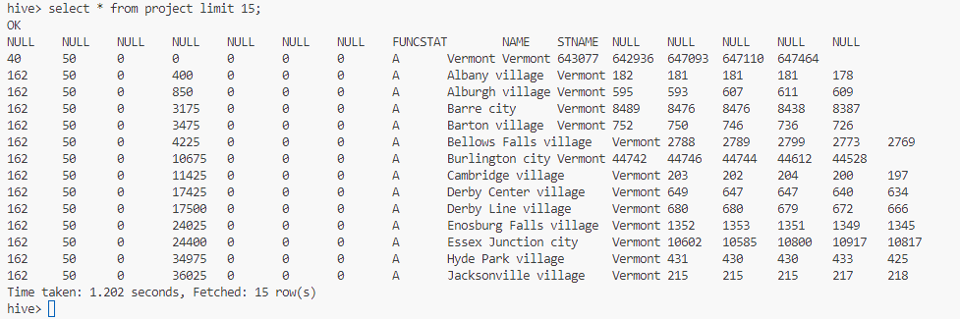
PROJECT THE SAMPLE DATA FROM THE TABLE WHICH GOT LOADED

